Slide 1
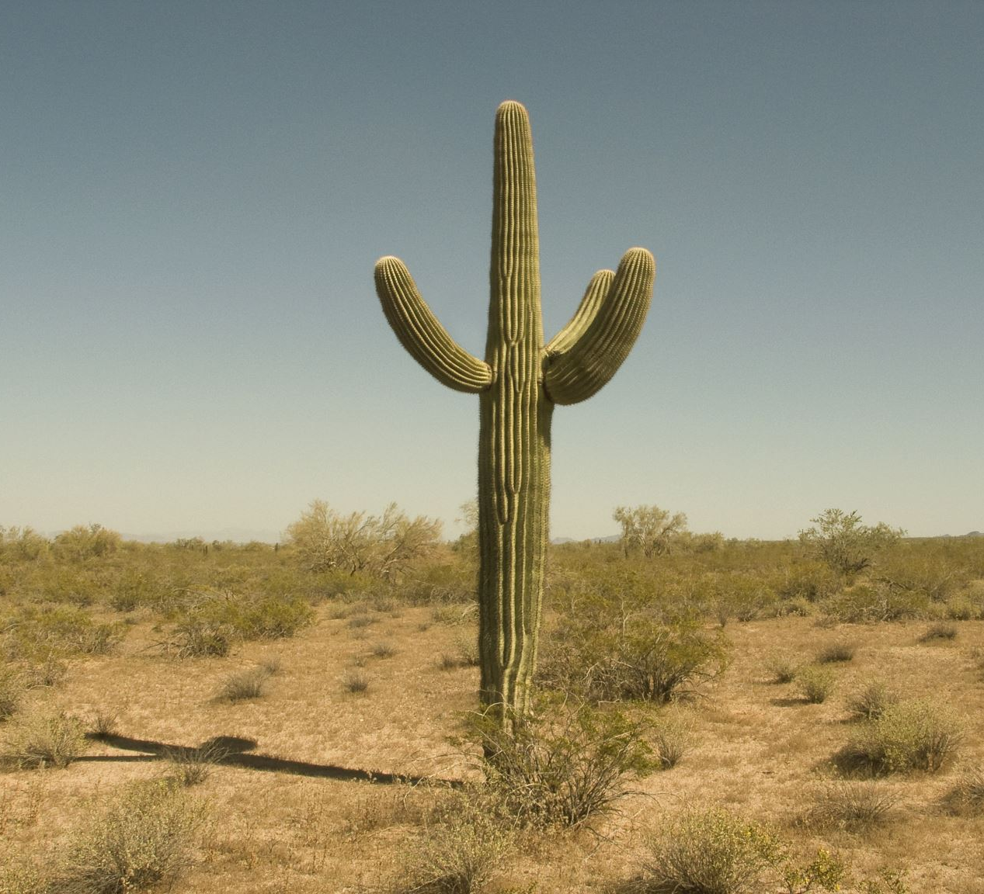
新旧-現代文明の幕開け
-7000億年分の文明開化- PART 01

Slide 2
You have walked around the city.
OH?
No anything, there is.
You have a bottle of water.
“What about you? “ that’s good?
you have greeting around the city.
The reason why to have a good travel.

Slide 3
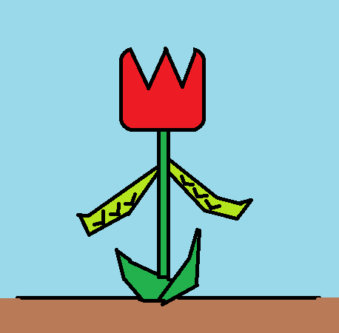
In the city, you find the plant.
Your acessment
Turip = 1521 beans = 7281
That plant is
→ 1521 is !
→ 1521 7281 is is !
→ turip and beans are !
→ Oh, monster ?

Slide 4
1521 is !
I tell you next things.
I’m not 1521.
You? Start at first. Please.

Slide 5
1521 7281 is is !
I tell you next things.
1521 7281.
That is a certainly.
However, your culture is
high-technology, isn’t it ?
So, you come you progress to there is!
→What do have a talking about me ?

Slide 6
turip and beans are !
Yes, you know.
I’m turip and beans.
A human fixed me to thins figure.
Hey, lower culture?
You can not notice soon,
so it makes up this one case.
Good, next.
→What do have a talking about me ?

Slide 7
Oh, monster ?
Oops!
What terrible things do you say.
I am not the monster!
Humm,
So, Shall we battle the next game?
→Coin toss is!
→word tieing is!

